Slide 1


SECTION 6
PPT Revision
Warning signs

Slide 2


Driving
No
Driving

Slide 3

Walking
No
Walking

Slide 4


Swimming
No
Swimming

Slide 5

Playing
No
Playing

Slide 6


Stop
Danger

Slide 7


is
.
Floodwater
dangerous

Slide 8
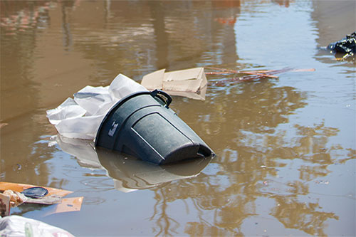
dirty
water

Slide 9
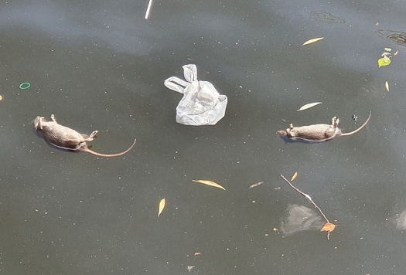
dead
animals

Slide 10
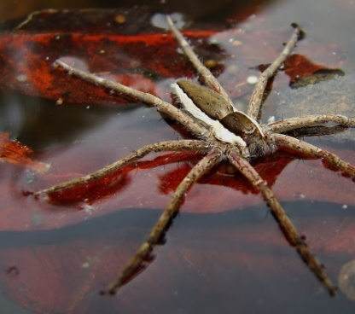
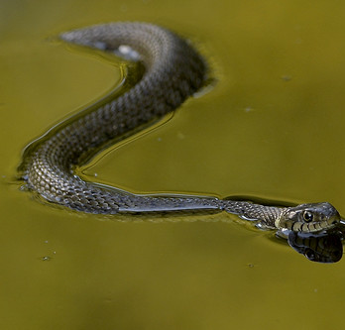
a snake
a spider

Slide 11
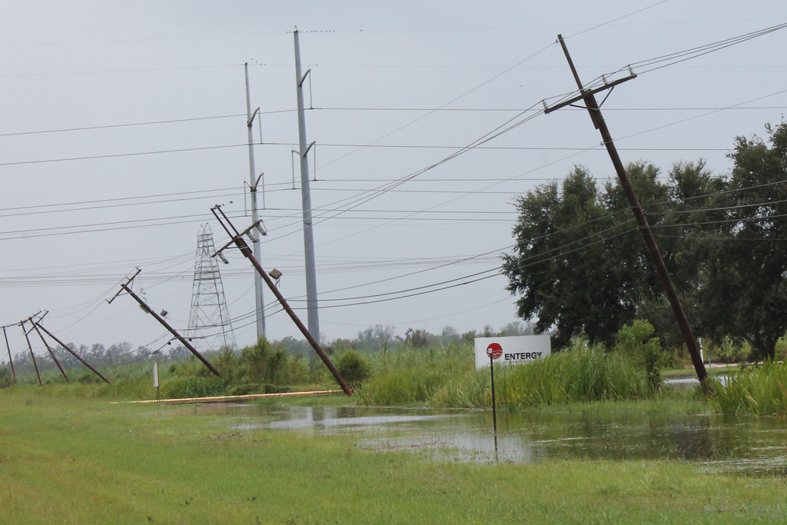

Electric
wires

Slide 12
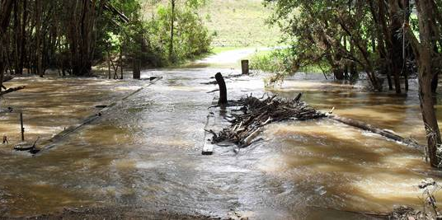
trees

Slide 13
Floodwater
is
dirty
and
dangerous
.

Slide 14
Picture acknowledgements
Driving sign | This Photo by Unknown Author is licensed under CC BY-SA
No driving sign | This Photo by Unknown Author is licensed under CC BY-SA
Walking sign | This Photo by Unknown Author is licensed under CC BY-SA
No walking sign | This Photo by Unknown Author is licensed under CC BY-SA
Swimming sign | This Photo by Unknown Author is licensed under CC BY-SA
No swimming sign | This Photo by Unknown Author is licensed under CC BY-SA
Playing sign | This Photo by Unknown Author is licensed under CC BY-SA
No playing sign Stop sign Danger sign | This Photo by Unknown Author is licensed under CC BY-SA This Photo by Unknown Author is licensed under CC BY-SA This Photo by Unknown Author is licensed under CC BY-SA
Dead mice | This image was originally posted to Flickr by Rolf Dietrich Brecher at https://flickr.com/photos/104249543@N07/48460862406 (archive). It was reviewed on 30 August 2019 by FlickreviewR 2 and was confirmed to be licensed under the terms of the cc-by-2.0.
rubbish | https://www.cdc.gov/nceh/toolkits/floods/default.html
Electric wires | This Photo by Unknown Author is licensed under CC BY-NC-ND
spider | This Photo by Unknown Author is licensed under CC BY-NC-ND
snake | This Photo by Unknown Author is licensed under CC BY-NC-ND
Drawing of house in floodwater | This Photo by Unknown Author is licensed under CC BY-NC
Project team
Vicki Hambling, Lorraine Hatcher-Friel, Sue Paull, Madelena Scott,
Mary Wallace, Visual Domain
Acknowledgements
The Project Team would like to thank the AMEP Service Providers and
practitioners who participated in the trial and gave valuable feedback.
CC 2021

Slide 15


This Floods Teaching Material is licensed under a Creative Commons Attribution-NoDerivs 3.0 Australia licence (More information is available here). You are free to use, copy and distribute to anyone in its original form as long as you attribute Department of Home Affairs as the author and you license any derivative work you make available under the same licence.
© Commonwealth of Australia 2021
With the exception of the Commonwealth Coat of Arms, the department’s logo, any material protected by a trade mark and where otherwise noted all material presented in this document is provided under a Creative Commons Attribution 4.0 International (https://creativecommons.org/licenses/by/4.0/) licence.
The details of the relevant licence conditions are available on the Creative Commons website (accessible using the links provided) as is the full legal code for the CC BY 4.0 licence (https://creativecommons.org/licenses/by/4.0/legalcode).
Use of all or part of this document must include the following attribution:-
© Commonwealth of Australia 2021
As far as practicable, material for which the copyright is owned by a third party will be clearly labelled. The department has made all reasonable efforts to ensure that this material has been reproduced in this document with the full consent of the copyright owners.
Copyright requests and enquiries concerning usage not addressed by the CC BY 4.0 licence should be addressed to:
comms@homeaffairs.gov.au at the Department of Home Affairs.
The terms of use for the Commonwealth Coat of Arms are available from the It's an Honour website.
Where a copyright owner, other than the Commonwealth, is identified with respect to this
material, please contact that third party copyright owner directly to seek permission.

